Slide 1


Slide 2
Bridge Pattern
Intent
  Decouple an abstraction from its implementation so that the two can vary independently
Also Known As
  Handle / Body

Slide 3

1. It's inconvenient to extend the Window abstraction to cover different kinds
of windows or new platforms
2. It makes client code platform-dependent.
Solution
Clients should be able to create a window without committing to a concrete
implementation.

Slide 4
The Bridge pattern addresses these problems by putting the Window abstraction and its implementation in separate class hierarchies.
There is one class hierarchy for window interfaces (Window, IconWindow, TransientWindow) and a separate hierarchy for platform-specific window implementations, with WindowImp as its root

Slide 5
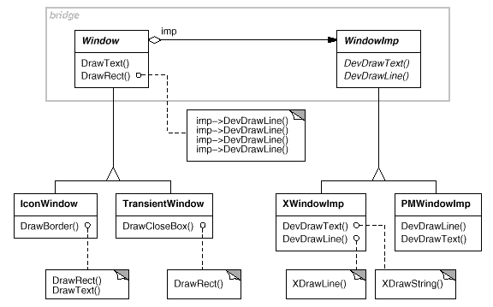

Slide 6
Applicability
1) You Want to avoid a permanent binding between an abstraction and implementation(runtime).
2) When abstractions and implementations should be extensible through subclassing(combined).
3) you want to hide the implementation of an abstraction completely from clients
4) you want to share an implementation among multiple objects ,, this fact should be hidden from client

Slide 7
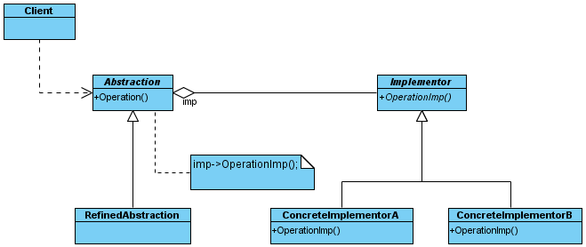
Pattern Structure
bridge

Slide 8
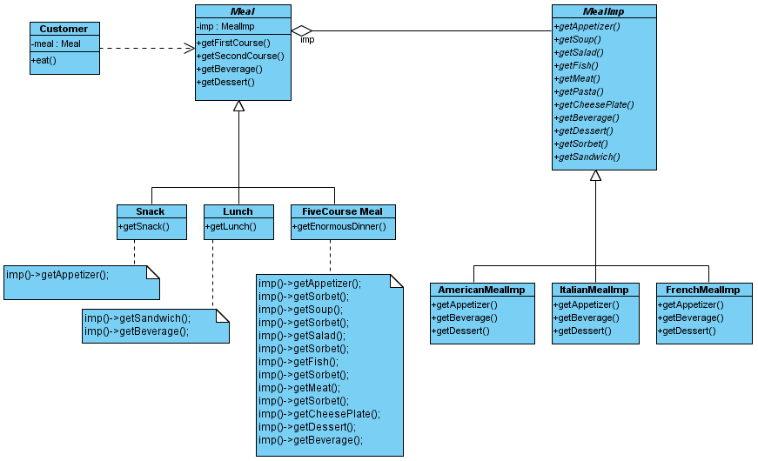
A Meal Example
bridge

Slide 9
Participants
Abstraction (window):
- define the abstraction’s interface
- maintains a reference to an object of type Implementor
Refined Abstraction (iconwindow):
- extends the interface defined by Abstraction
Implementor (WindowImp):
- defines an interface for implementation classes.
concreteImplementor ((XWindowImp, PMWindowImp):
- implements the Implementor’s interface and defines its concrete implementation.

Slide 10
Collaborations
· Abstraction forwards client requests to its Implementor object.
Consequences
1. Decoupling interface and implementation
2. Improved extensibility(Abstract and Implementor hierarchies independently)
3.Hiding implementation details from clients

Slide 11
Implementation
1) Only one Implementor
2. Creating the right Implementor object.

Slide 12
Related Pattern
An Abstract Factory (99) can create and configure a particular Bridge.

Slide 13
Consequences
decoupling interface & implementation
  - implementation of abstraction - can be configured at run-time
  - eliminate compile time dependencies on implementation
  - encourages layering
improved extensibility
  - Abstraction & Implementer - can be extended independently
hiding implementation details from clients

